Slide 1
About MCPA
Myanmar Computer Professionals Association

Slide 2

About MCPA at a Glance
Brief History
Current Overview
Established in 1998
Computer Science Development Law (10/1996)
Past Presidents:
U Thein Oo
U Thaung Tin
U Khun Oo
U Ye Yint Win
Over 15,000 members
9 Regions & States in Myanmar

Slide 3
Objectives & Activities
Objectives
Activities at a Glance
To carry out objectives stated in the Computer Science Development Law
To connect ICT professionals throughout the entire country
To organize regional associations
Seminars, Workshops, Consultations
Developer Conference
BarCamp
ICT Lab, Training
Industry Visit
ICT Exhibitions, Conferences
Professional Series (Publishing)

Slide 4
Membership
Types of Membership
Fees
Student Member
Associate Member
Ordinary Member
Fellow Member
Enrollment Range from 1,500 Kyats to 4,000 Kyats
Yearly Fee range from 2,000 Kyats to 6,000 Kyats

Slide 5
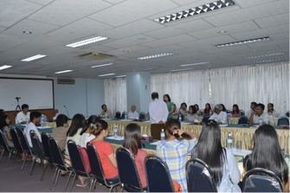
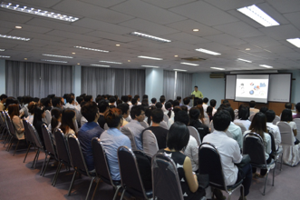
Seminars
Workshops
Seminars

Slide 6
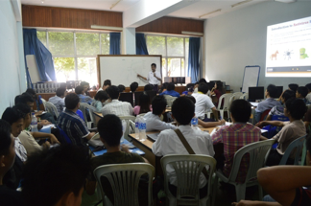
Examinations
ITPEC (Japan)
May / October
IT Passport Exam (IP)
Fundamental IT Engineer Exam (FE)
Applied IT Engineer Exam (AP)

Slide 7
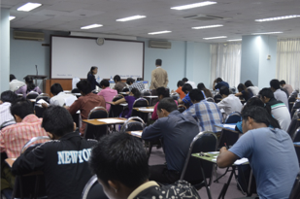
Examinations
MCPA Exam Certificate
June / December
MCPA Certified Fundamental Software Engineer (FSE)
MCPA Certified Network Associate (NA)
MCPA Certified Software Engineer (SE)
MCPA Certified Network Professional (NP)

Slide 8
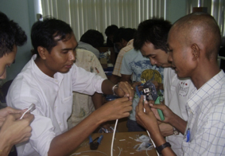
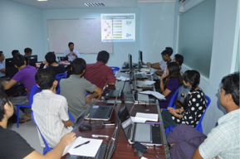
ICT Lab & Trainings
Hands-On at ICT Lab
Delivering Lectures

Slide 9
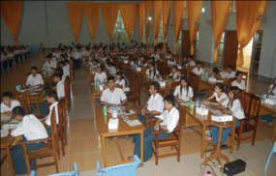
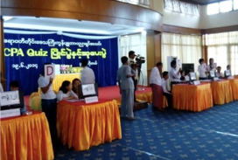
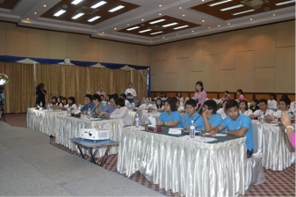
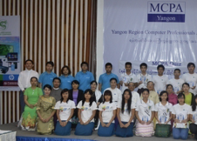
MCPA Quiz

Slide 10
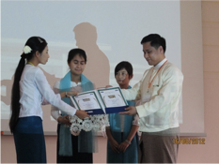
MCPA Academic Excellence Awards
Brief Overview
Awarding a Student at UCSY
Top 10 students at computer universities are eligible for MCPA Academic Excellence Award
2.5 Lakhs Per Year
Beginning 2010-2011 Academic Year
To expand to more universities in Myanmar

Slide 11
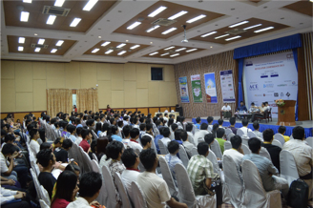
Developer Conferences
Brief Overview
Annually since 2011
40 speakers
1,000 paying registered attendees per year
Technical papers are presented
Very technical, academic

Slide 12
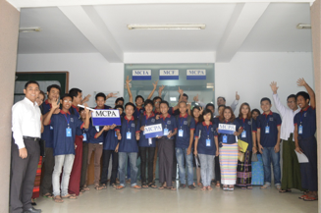
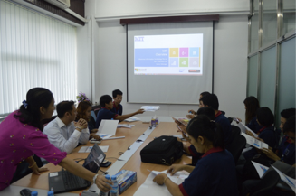
Industry Visits

Slide 13
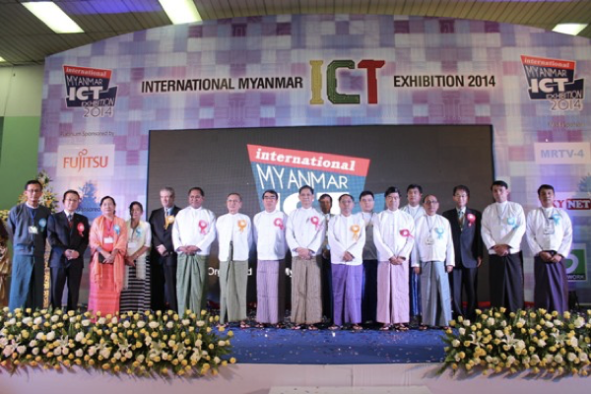
ICT Exhibitions & Conferences

Slide 14
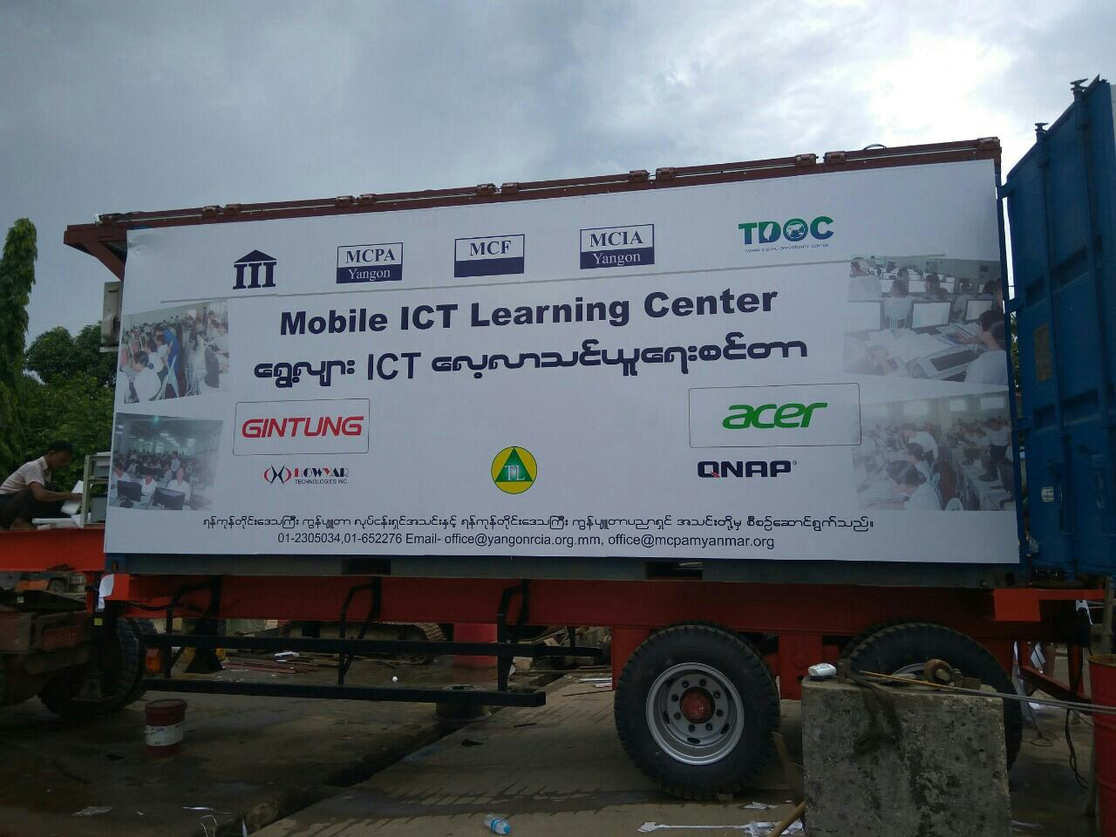
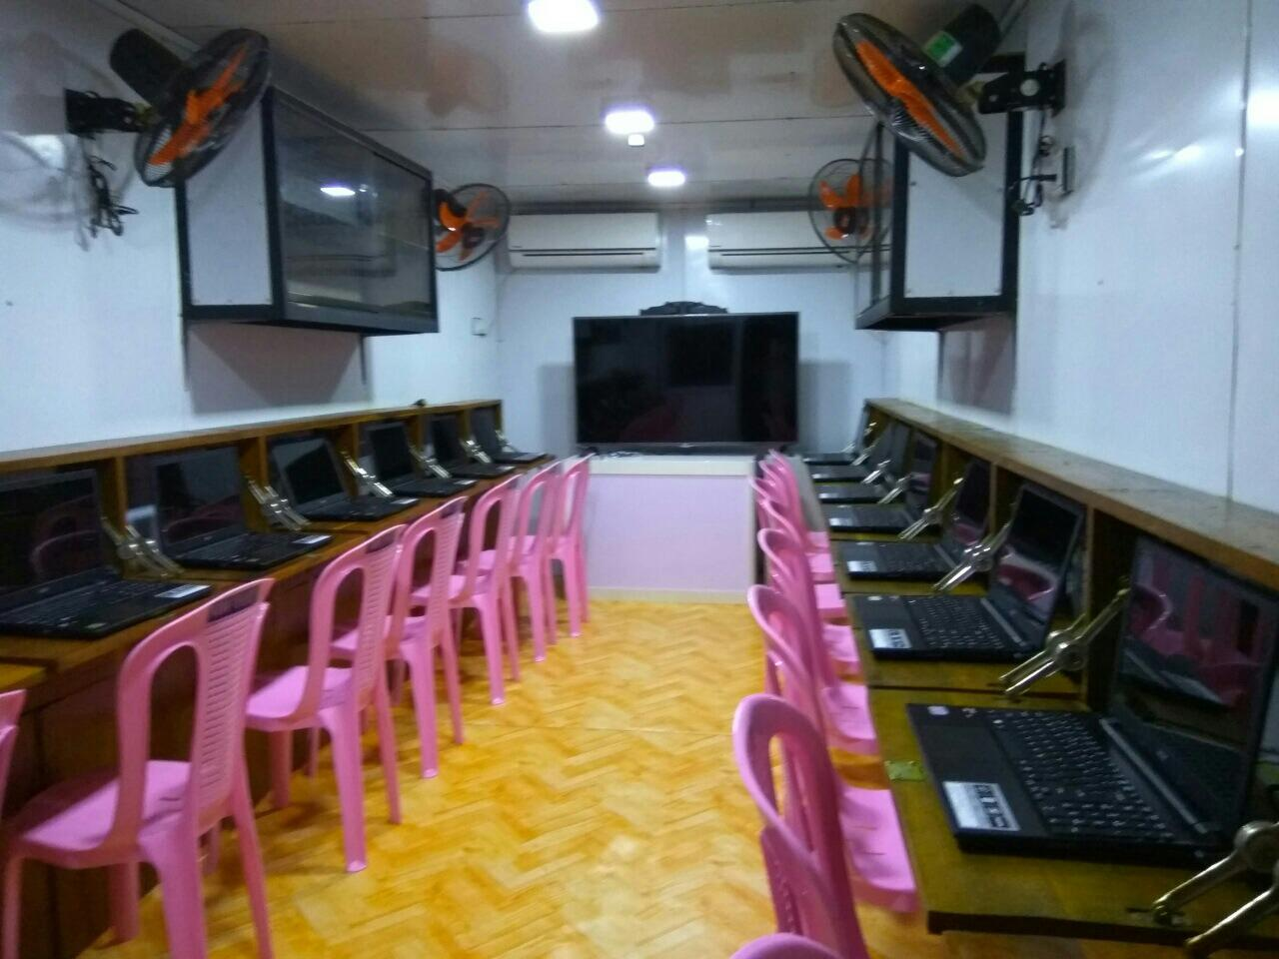
Mobile ICT Learning Centers

Slide 15
Thank You!

